Slide 1
Global Carbon Emission Comparisons
Group 15 - Ruchita, Avneesh, Tarini, Kobe, Mikhail

Slide 2
Topic Description
Alarming rates of carbon emissions
Study major factors affecting climate conditions
Analyze correlations between energy usage and GHG emissions through transportation
Determine the recent impact of alternative energy sources
Predict future impact of higher alternative energy adoption

Slide 3
Data Description
Annual worldwide vehicle mix by different energy types. (Diesel, Electric, Hybrid, etc.)
Overall GHG emissions by sector
Market demand of all vehicles types.
Energy production.

Slide 4
Database
Downloaded datasets related to co2 emissions and GHG emissions. Source- https://ourworldindata.org/
Tried to find the unique key to merge the data in this case it is the country name and year.
Collected the datasets for Transport Vehicle demand country wise and year wise, merged it with the GHG emissions database.

Slide 5
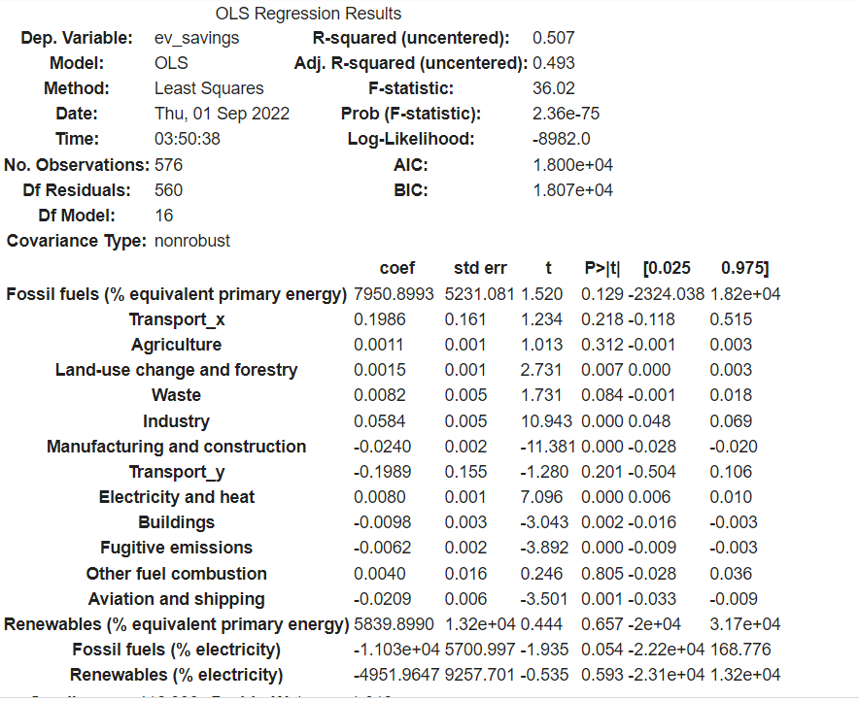
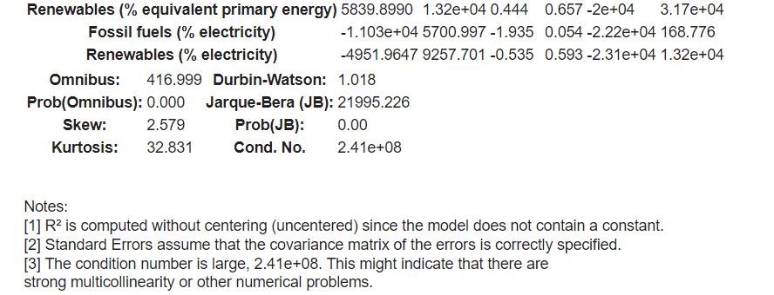
Machine Learning Model Summary

Slide 6
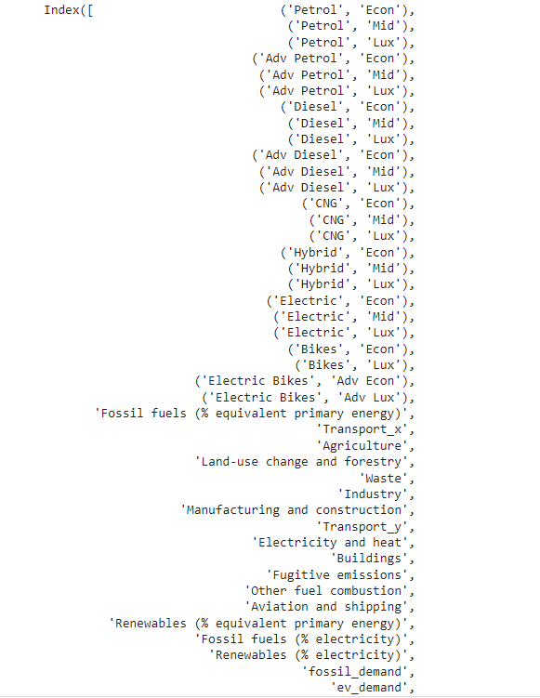
Machine Learning Model - Data columns
To calculate CO2 emissions saved by electric vehicles year by year.
Features given in the screenshot are taken into consideration.

Slide 7
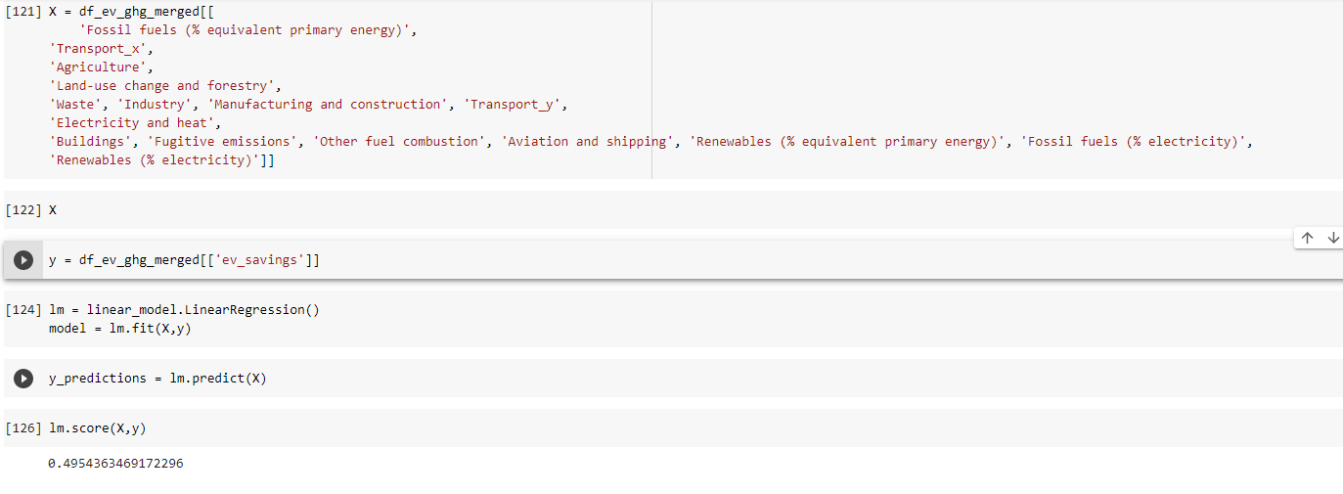
Machine Learning Model Output

Slide 8
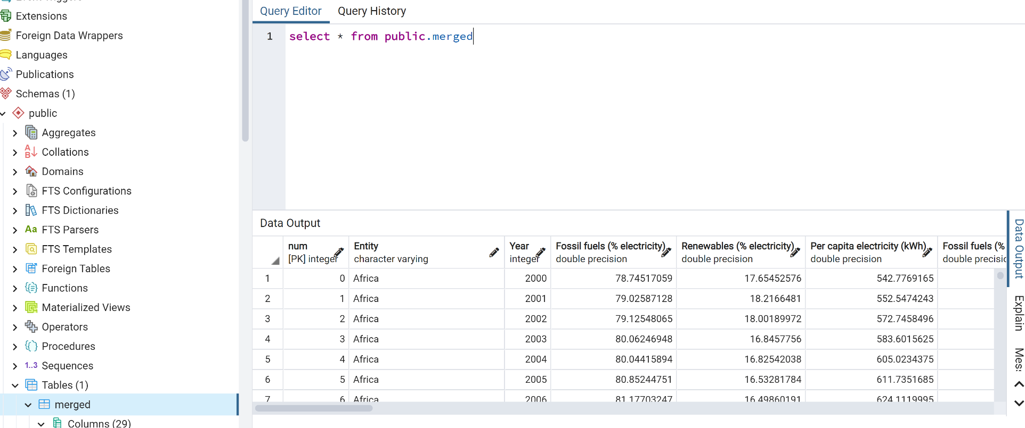
Database Sample

Slide 9
Next Steps…
Explore and analyze data to study the impact of various vehicles by energy type on carbon emission
Determine if there is a significant correlation between each factor
Reveal possible outcomes of alternate energy consumption on carbon & GHG emissions
Summarize each step taken in the machine learning preprocess.

